Slide 1
SuperSpheres
Joseph Josue Forestal
Le Tuan Huy Nguyen
Jameel Hassan
Fadi Rasmy

Slide 2
Project Idea
Project Ideas | Description
Tony | Walking simulator, where the player controls the muscles
Joseph Josue | 3D-space Simulation or game in 3D
Fadi | Pen tester, to locale router and network points using triangulation.
Jameel | 2-D physics simulator

Slide 3
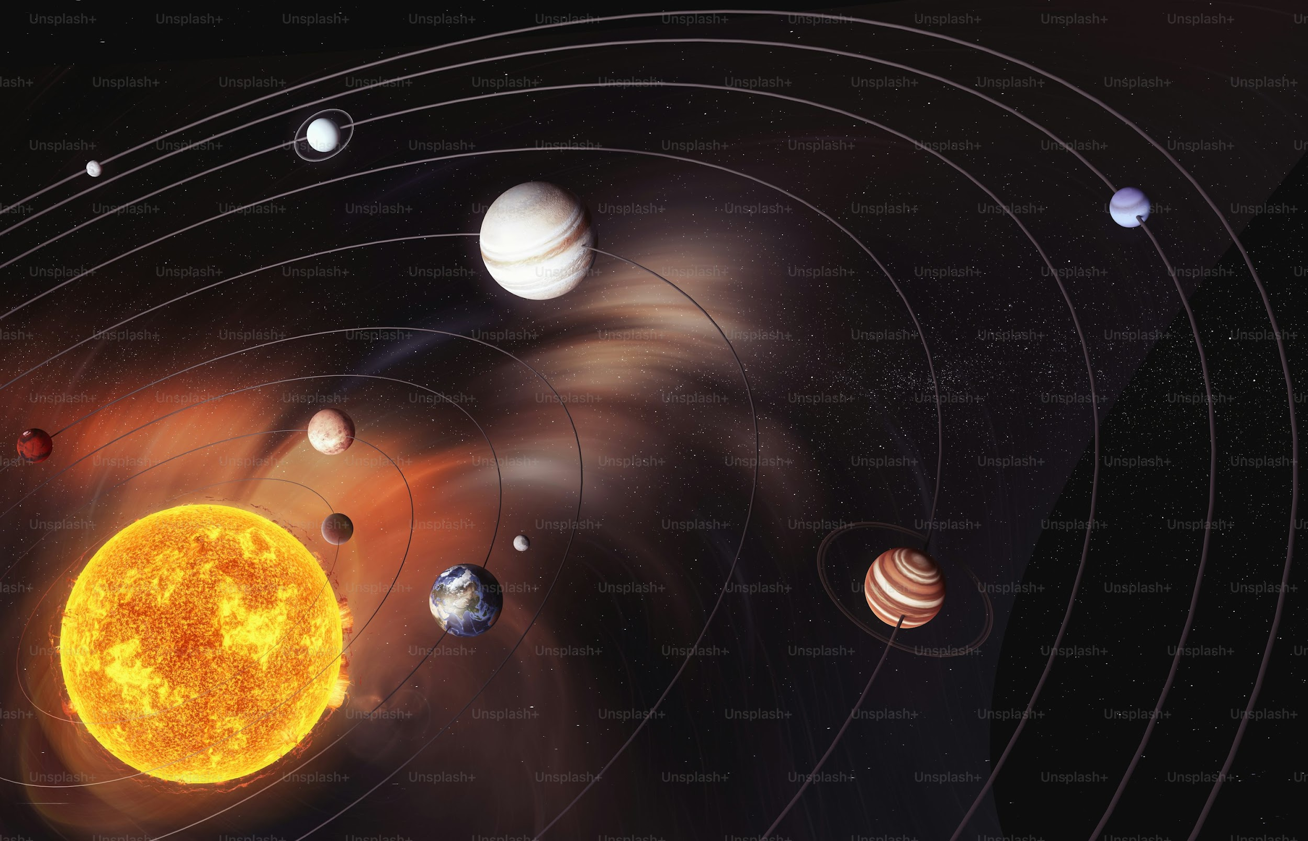
Simulate and visualize how gravity affects celestial bodies
Provide an interactive “sandbox” mode for users to create systems
Apply real-world physics concepts in an engaging way

Slide 4
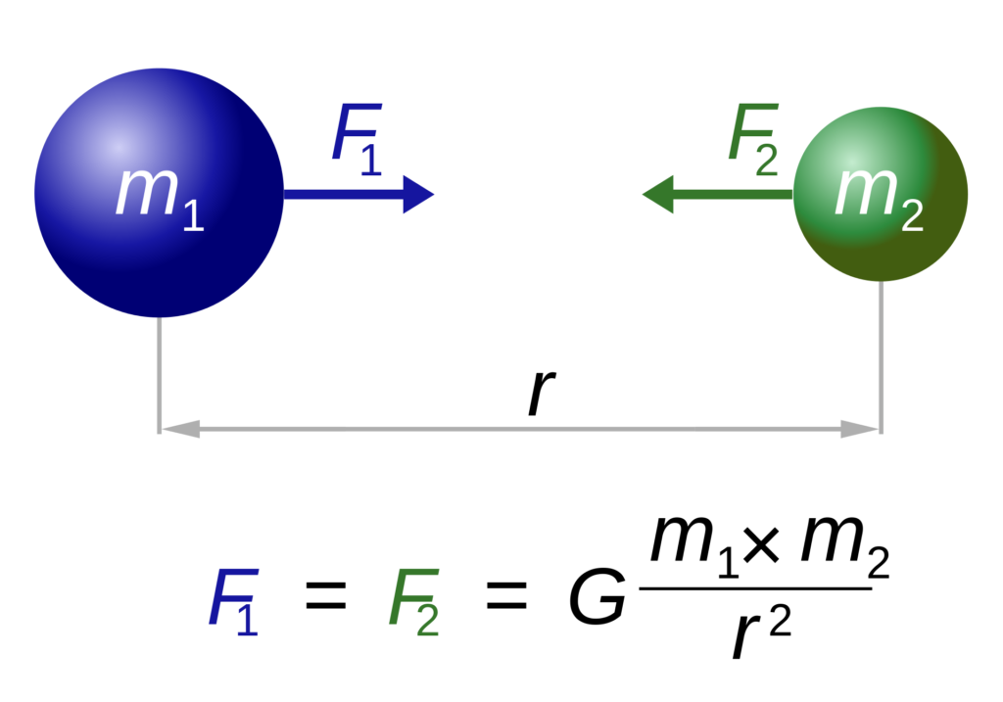
Gravity

Slide 5
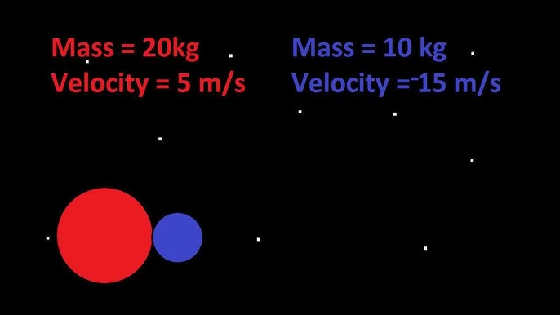
Momentum and Forces
Momentum
The motion of celestial bodies is based on their mass and velocity
Formula: p=mv
Forces
Net forces determine how objects move in space
Formula: F=ma

Slide 6
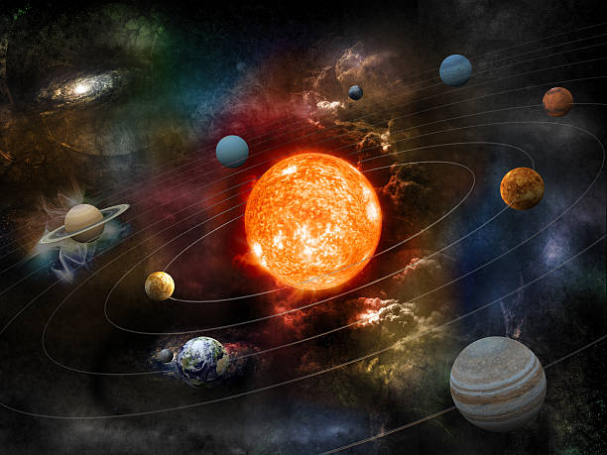
Features : Celestial bodies
Types of celestial bodies:
Asteroids(If possible), planets, stars
Movement:
Objects move based on gravitational forces
Trails show movement history
Collisions (if possible):
Objects can merge or bounce off each other

Slide 7
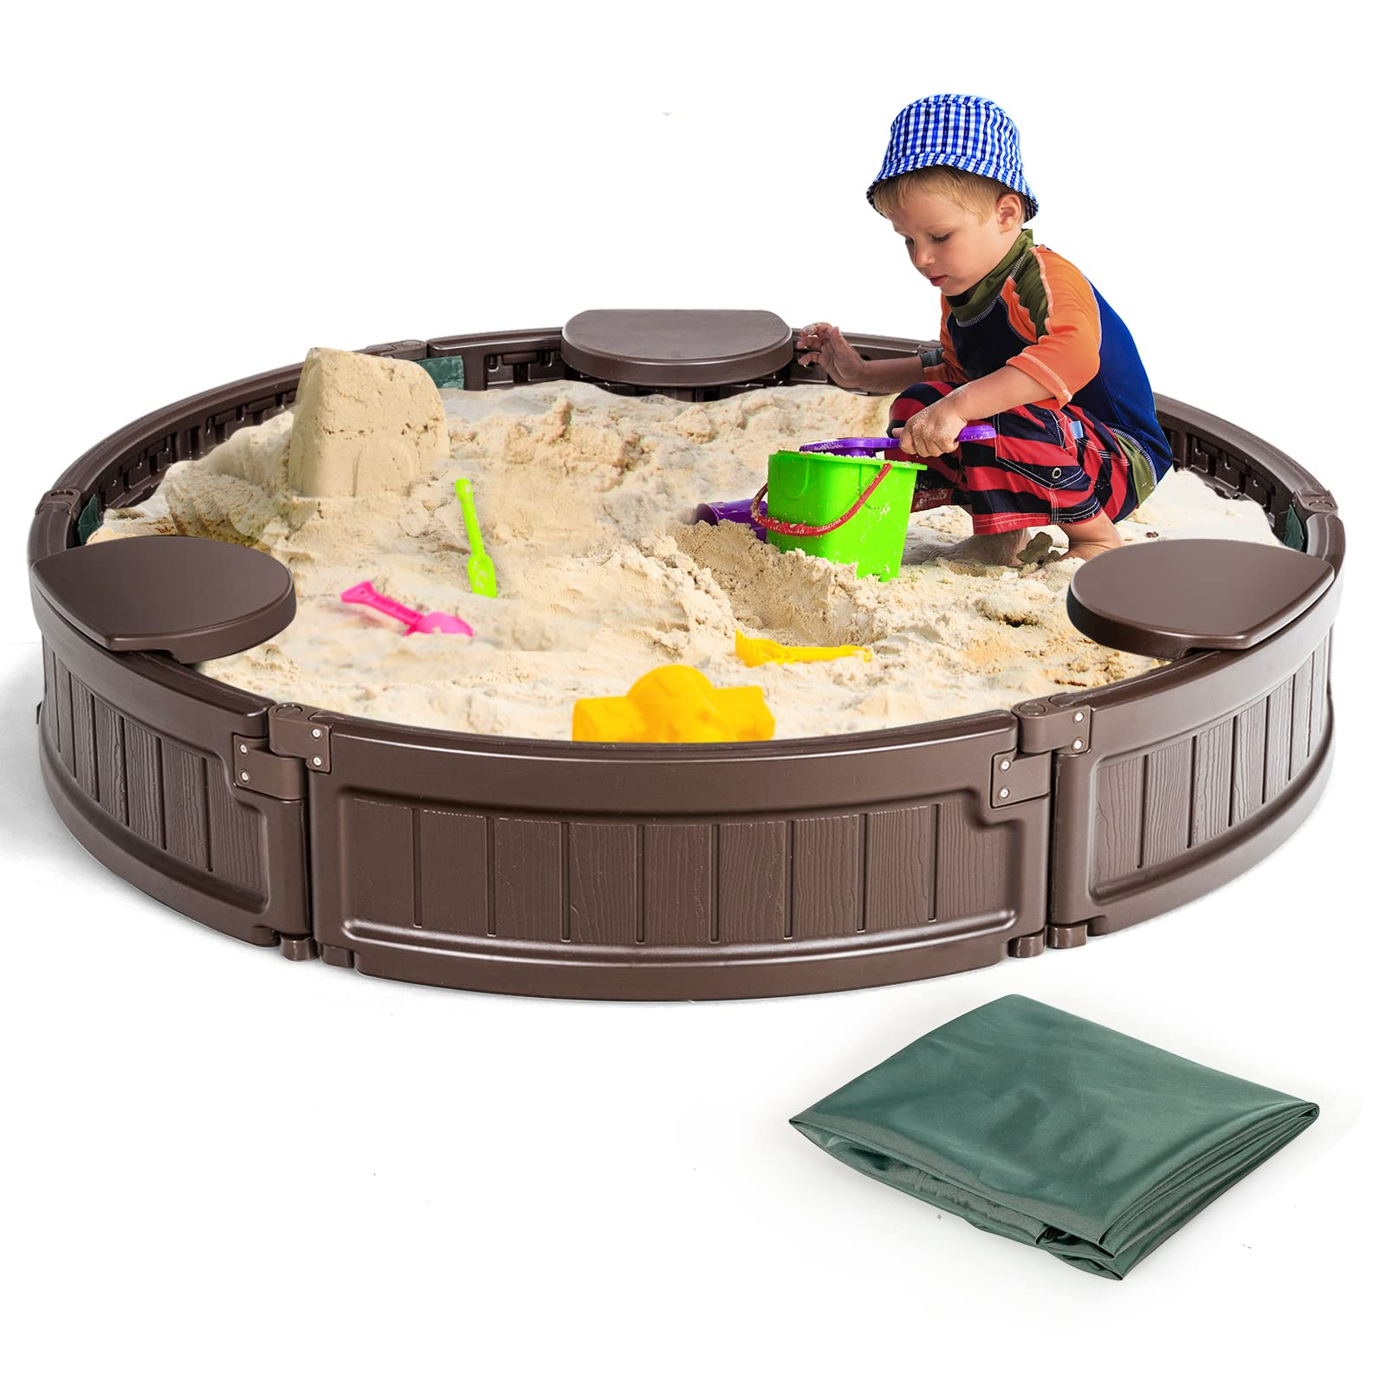
SandBox feature
User-created systems:
Start with an empty space or a preset system
Spawn planets, stars, or asteroids
Simulation Controls:
Adjust mass, position, and velocity
Observe how they interact over time
Saved environment
Load pre -set environment(it means you can already have the solar sytem)

Slide 8
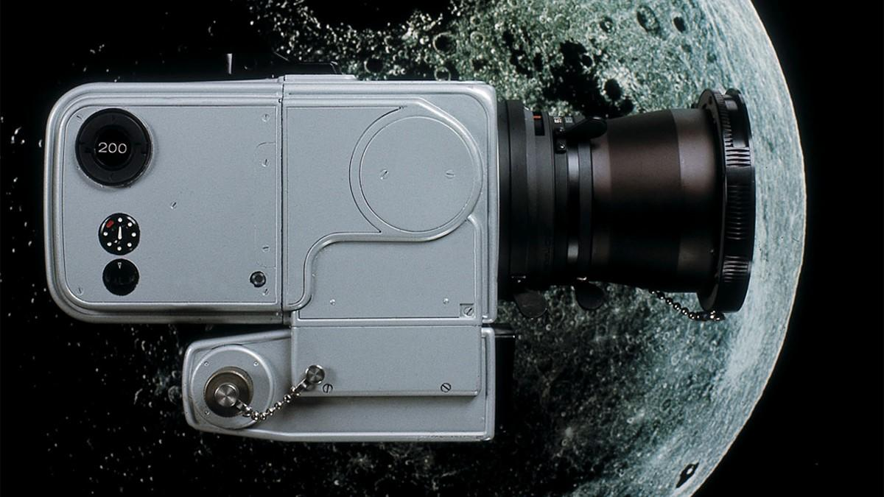
Camera’s features
Camera Controls:
Free movement or lock onto a planet
Pause/Play Function:
Stabilize positions for observation
Info Window:
Displays mass, velocity, and other properties

Slide 9
Usage Scenarios
Educational Resource
Explore Physics:
See how gravity affects celestial objects
Simulate the Solar System:
Understand planetary motion through visualization
Test Hypothetical Scenarios:
Experiment with different celestial setups

Slide 10
Relevance
STEM Education:
Helps students understand physics concepts in action
Visual Learning:
Makes mechanics and astrophysics more interactive
Real-world Applications:
Similar simulations are used in space research

Slide 11
Feasibility
May use Scene builder
Might use MeshParts (which is a free open javafx code )(for asteroids)
Javafx’s containers especially groups
The scene’s camera

Slide 12
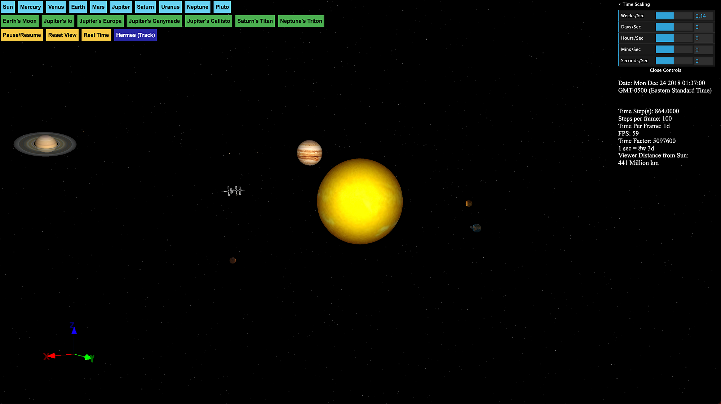

Slide 13
Task division
Team members | Task
Joseph | Mathematics and calculation
Tony | Graphics
Jameel | 3-D texture and resources
Fadi | UI / user input

